Slide 1

LOCAL SEARCH SYSTEM FOR WIKI NEWS
SHASHIDHAR REDDY DAIDA
ROHITH REDDY POREDDI
ASRITHAMARY KONDAVEETI
SHRESTA SANKAPALLY

Slide 2
LOCAL SEARCH SYSTEM FOR WIKI NEWS
Objectives:
To develop an effective and efficient Local Search System for Wiki News.
Scrap the news data from wiki news website and store in the local database.
Provide an efficient user interface for users where user can search and read news content.
Maintained by Admin who has access to user management, item management, Scrapping and Indexing
User Information.
Latest news of wiki news in the local database.

Slide 3
Technologies used:
UI: HTML, CSS & JavaScript
Dynamic web pages: Django
Database: MySQL

Slide 4
Modules:
User Management
Scrapy Management
Item Management
Indexing

Slide 5
User Management
Admin
Anonymous User

Slide 6
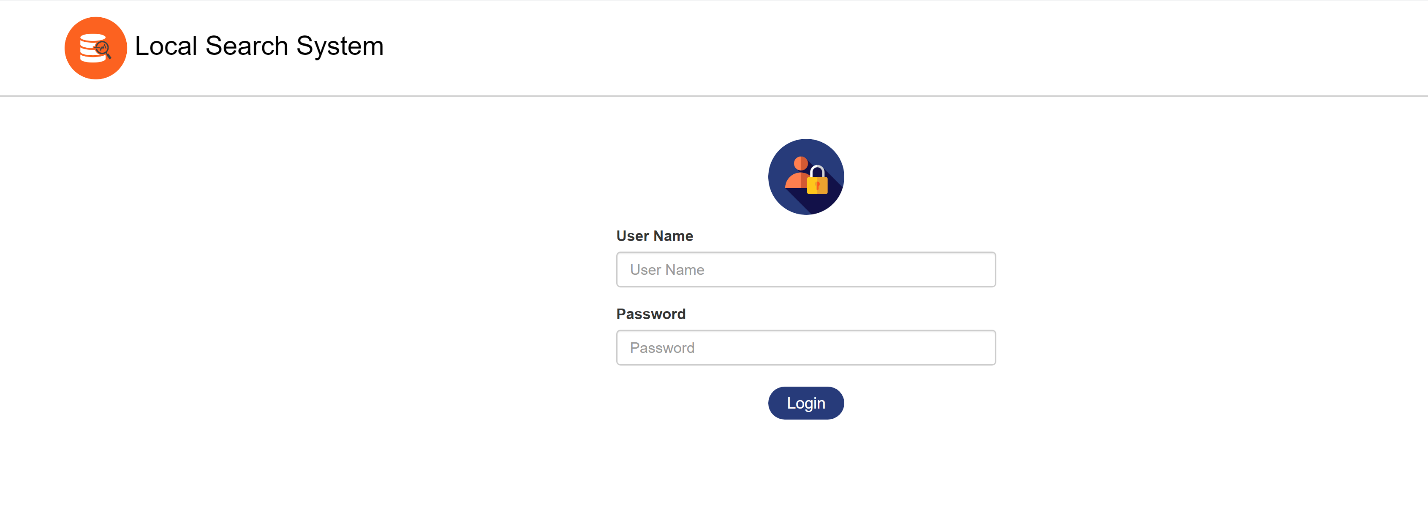
Login page of Local Search System

Slide 7
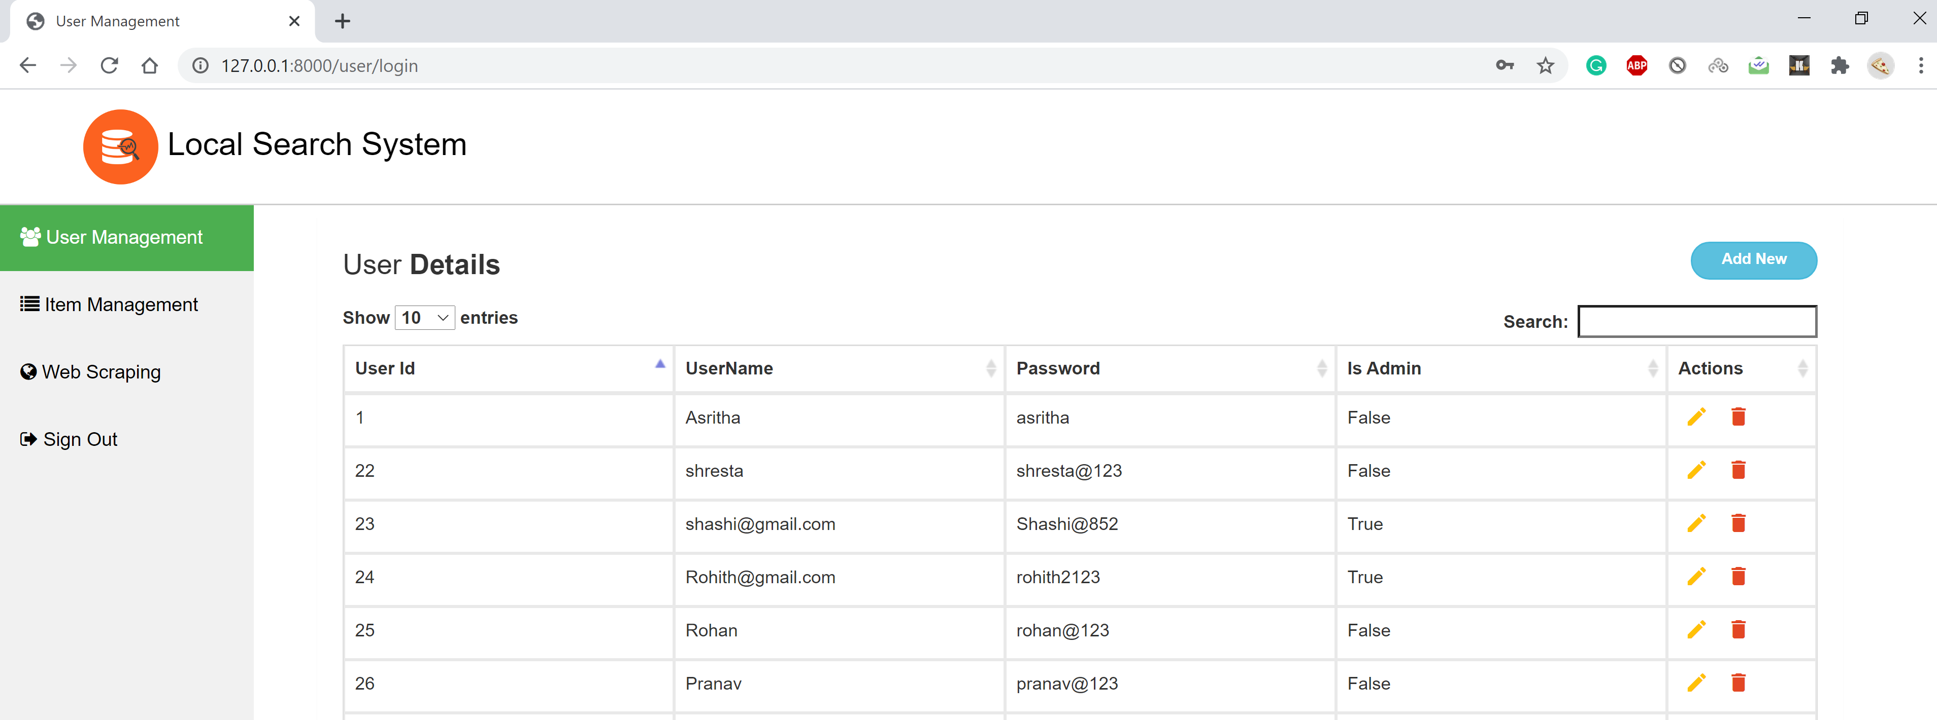
Admin login page – User Management

Slide 8
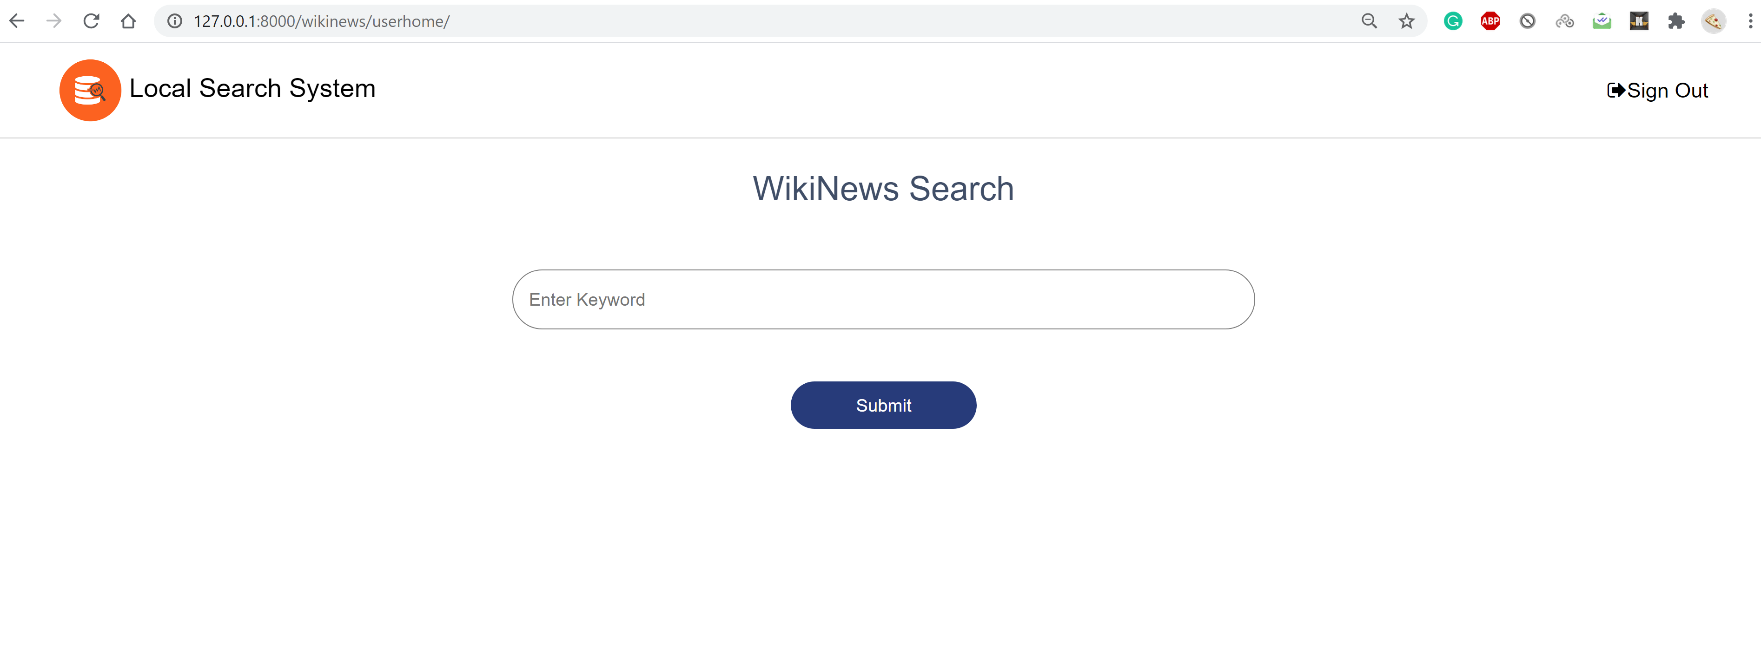
Anonymous user login page

Slide 9
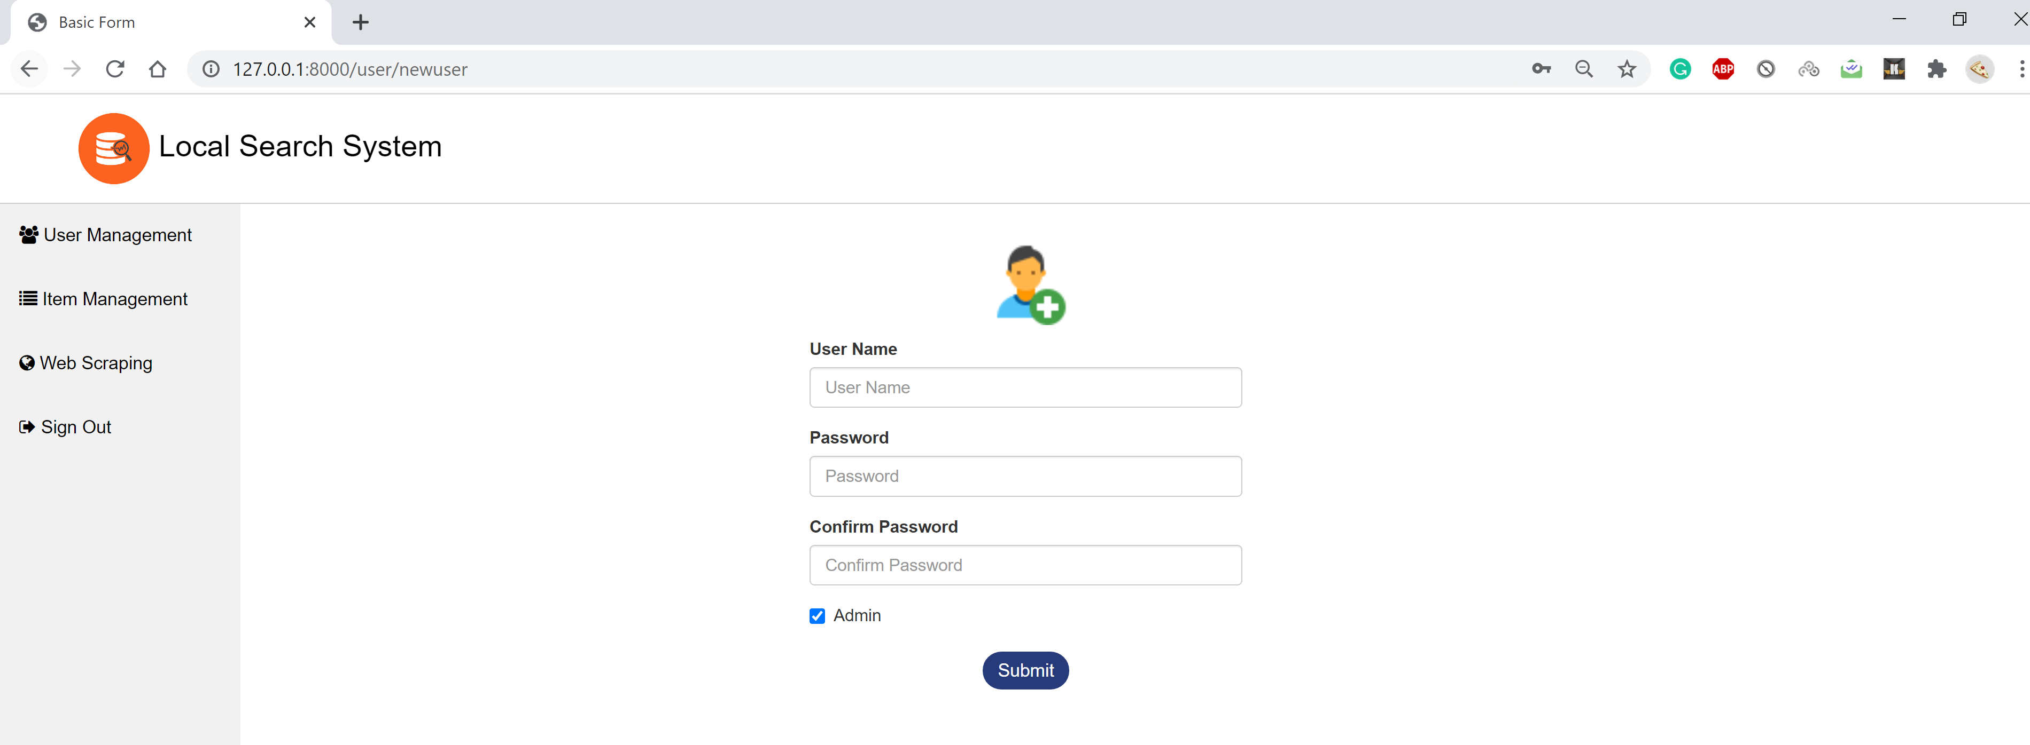
New User Page

Slide 10
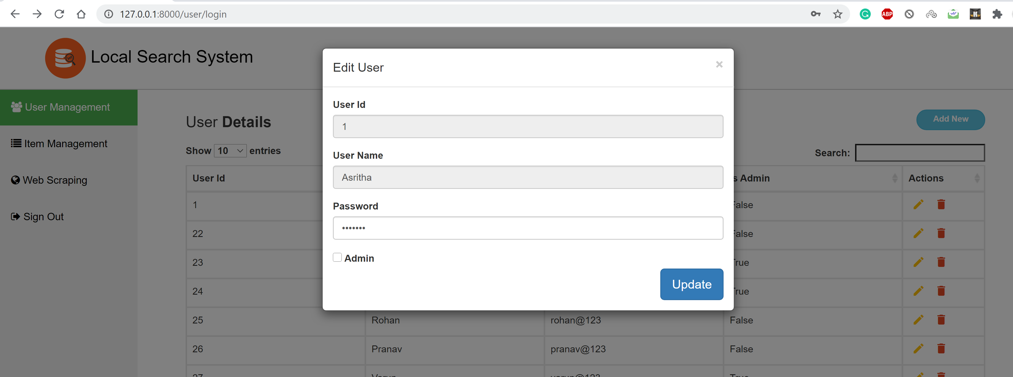
Edit User Page

Slide 11
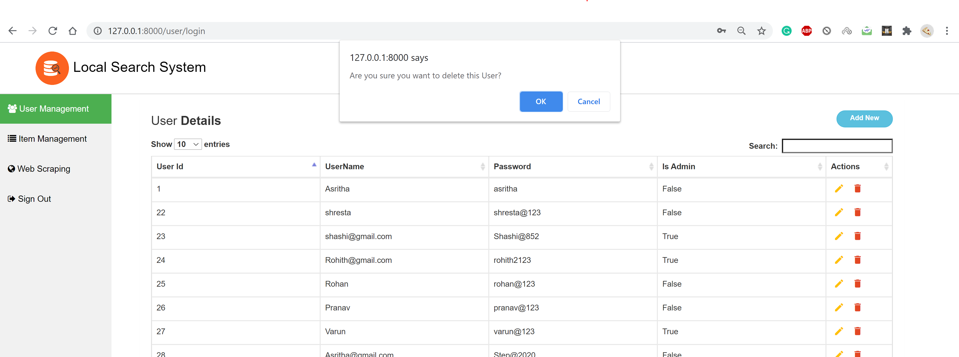
Delete user

Slide 12
Web Scrapping
Scrapping the data using Python web scrapy package from https://en.wikinews.org/wiki/Main_Page
Scrap the content and images of the news items and storing in the localsearchsystem database.

Slide 13
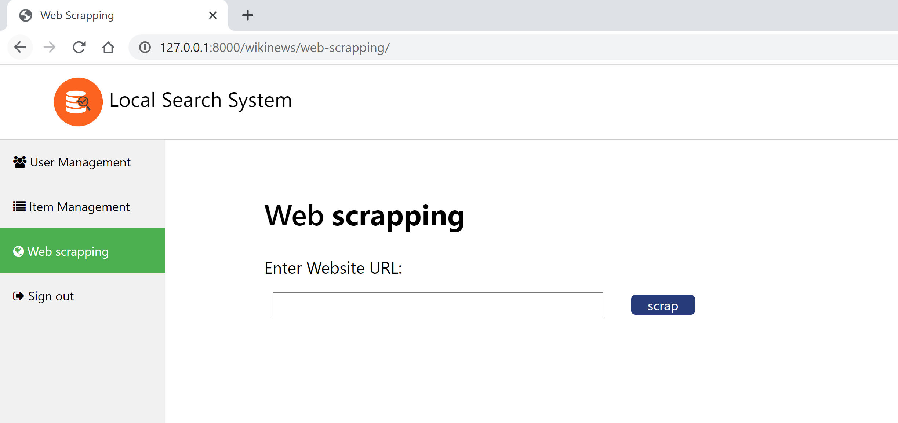
Scrapping page

Slide 14
Item Management
Admin activity:
View
Edit
Delete

Slide 15
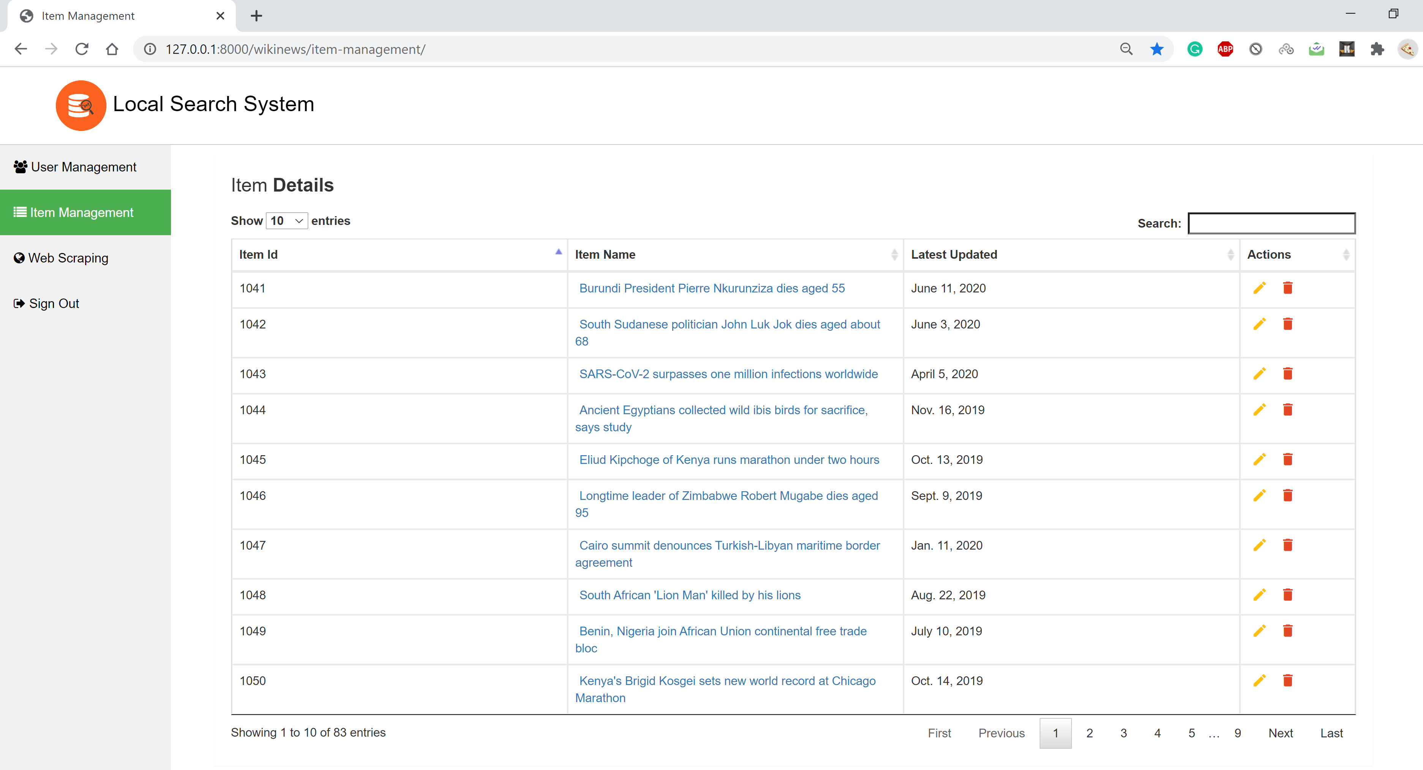
List of items available in the local database:

Slide 16
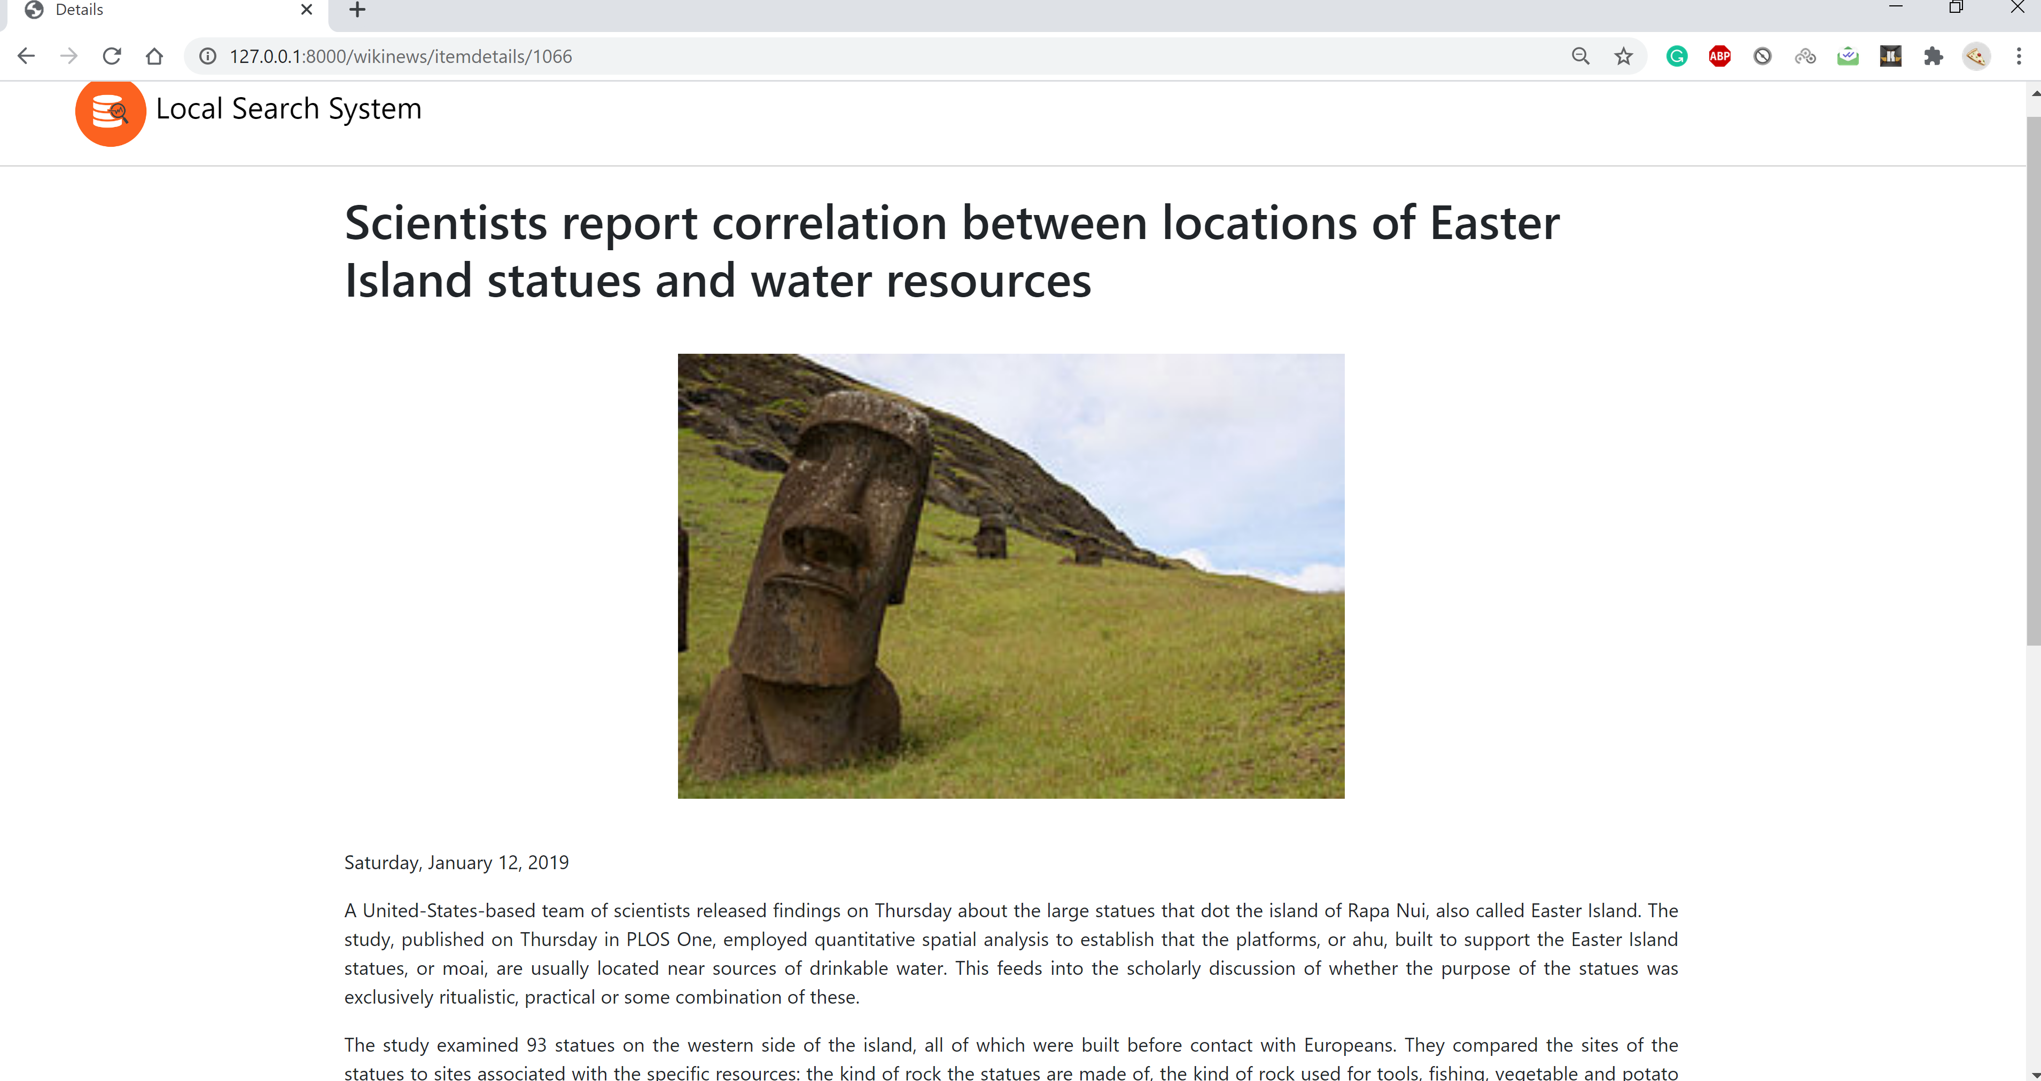
Detail page of item:

Slide 17
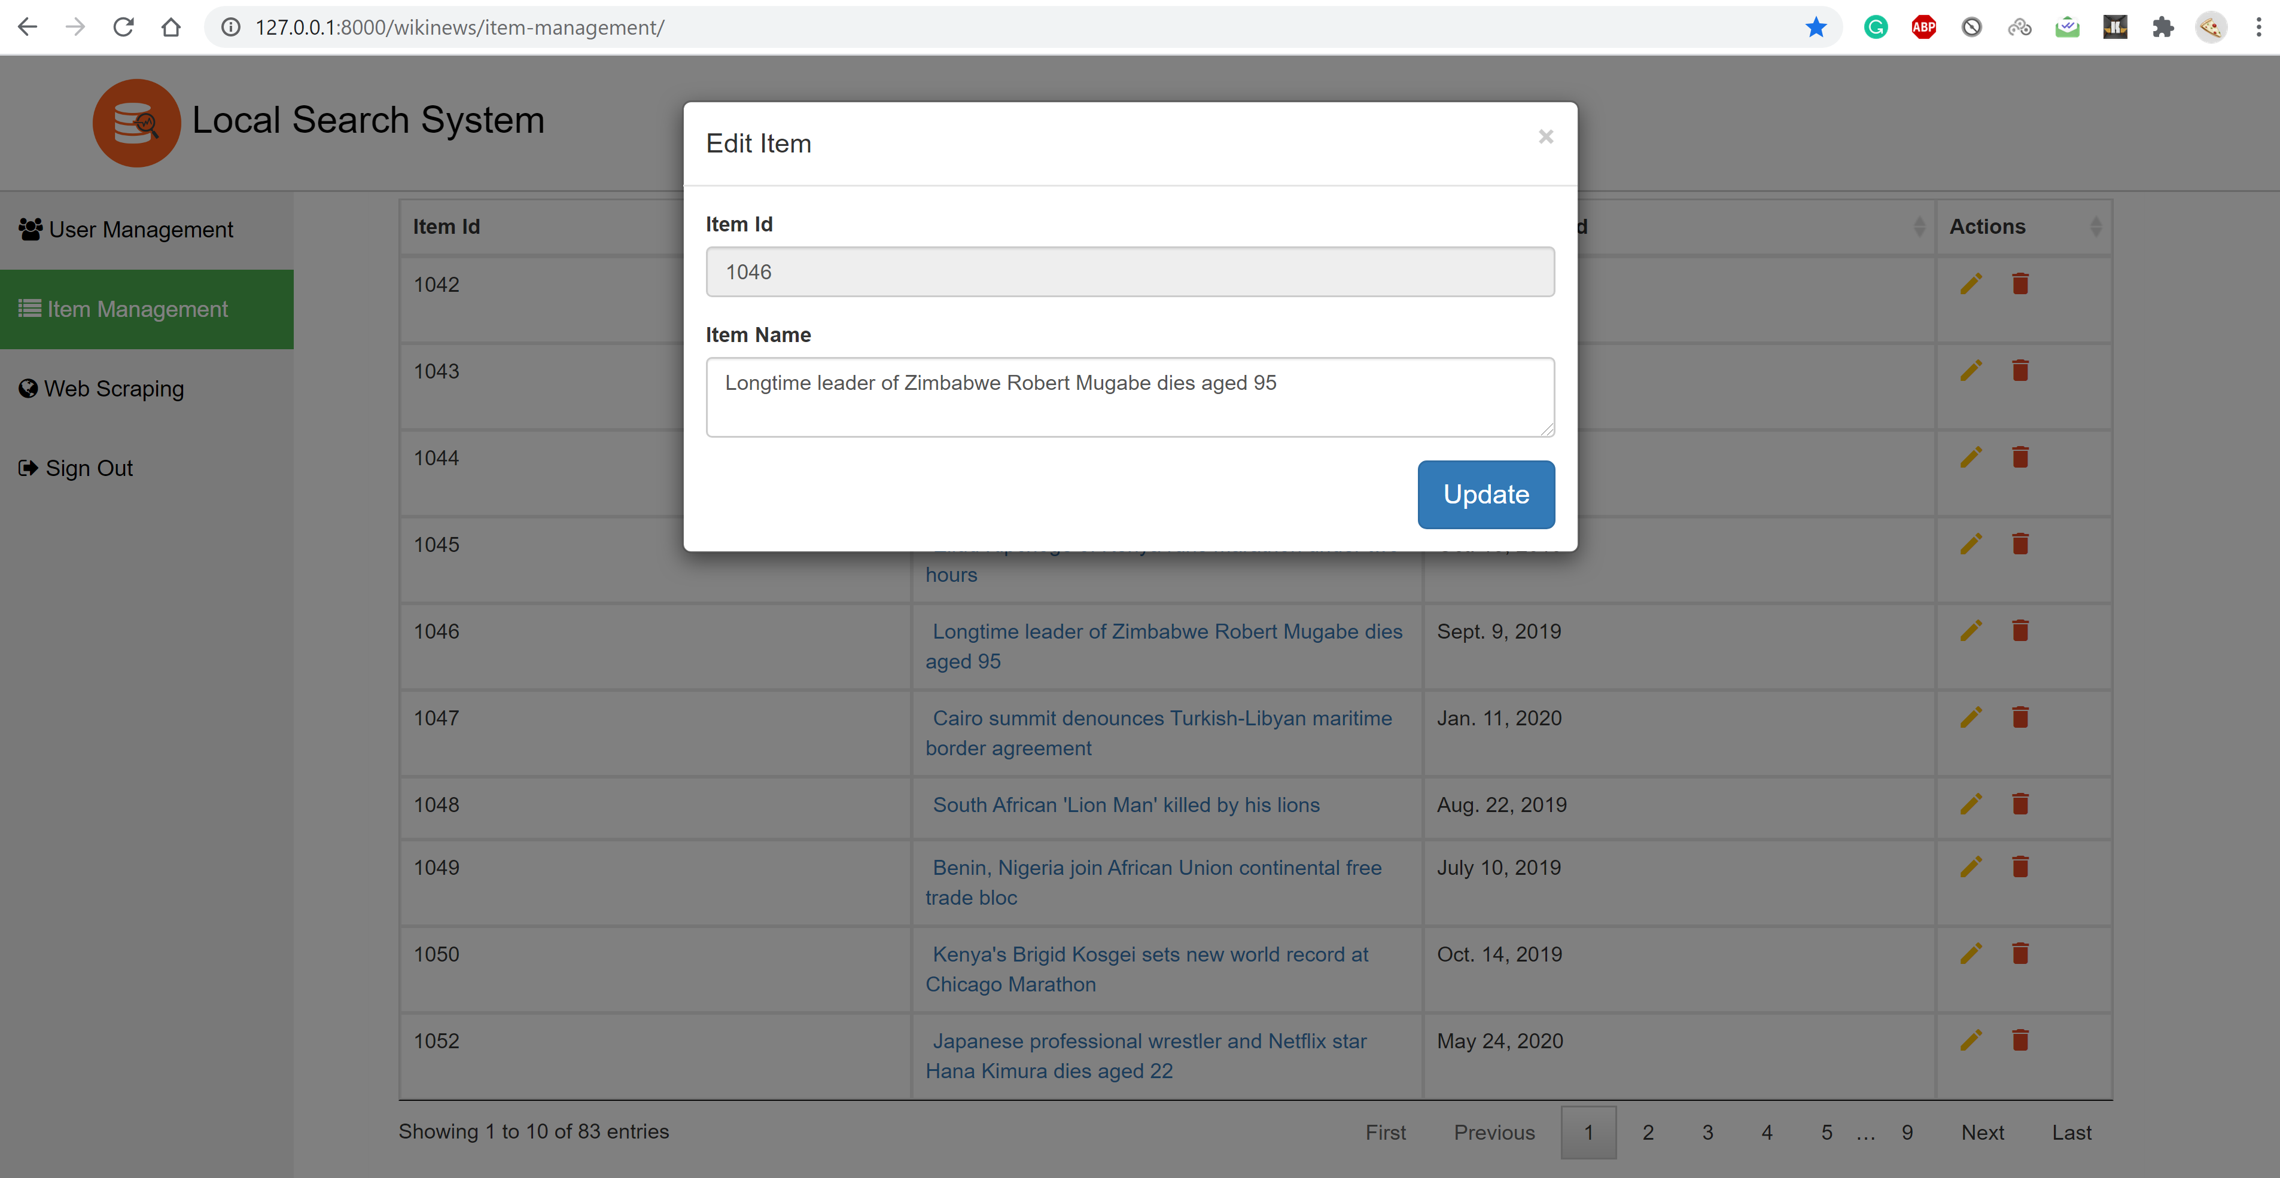
Edit Item:

Slide 18
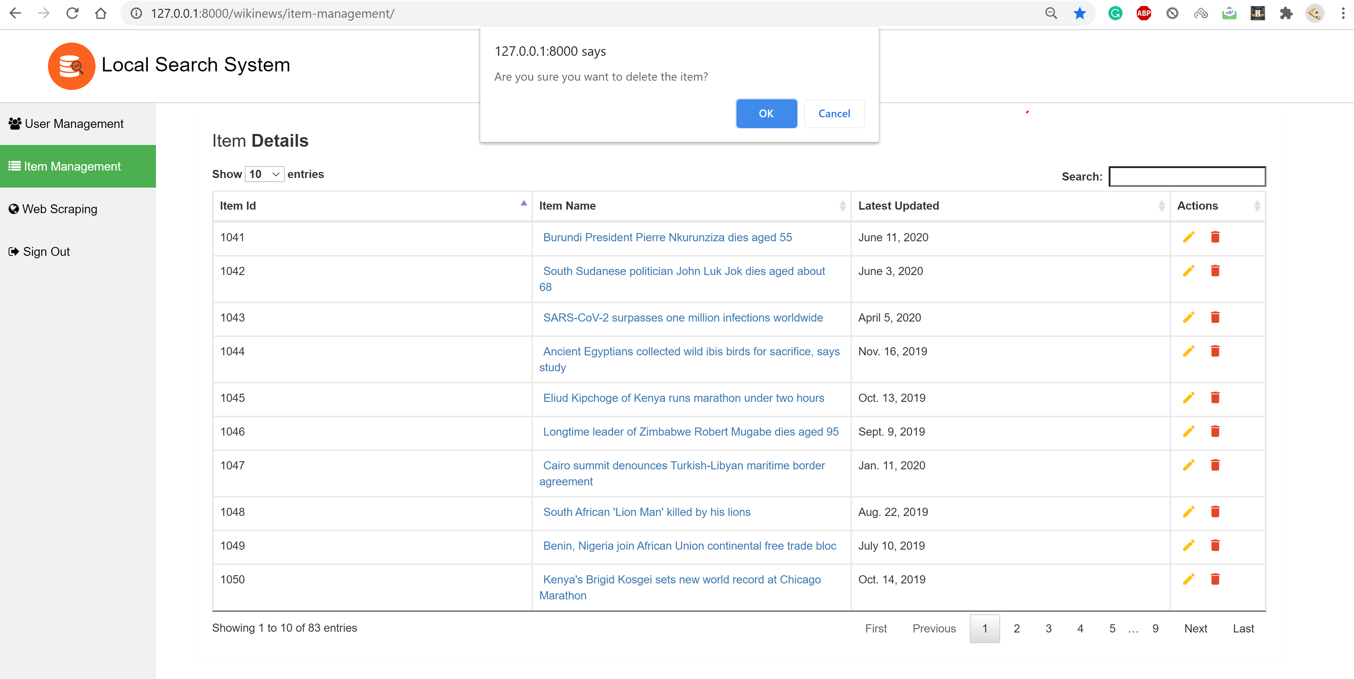
Delete Items:

Slide 19
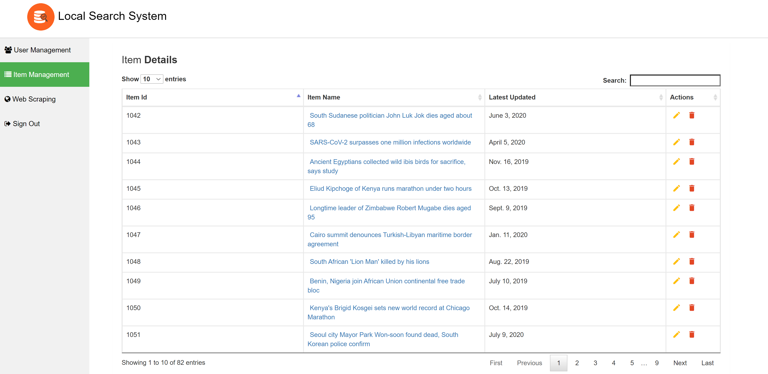
Updated page once item is deleted

Slide 20

Indexing
Provides search engine for searching and retrieving the news items from local database.
Django Haystack is used as search algorithm which implements the indexing part in the backend.
Elastic Search Engine is used in the backend

Slide 21
How Indexing works?
Define an Indexing function where it is mentioned about the model and fields of the model on which Indexing should be applied.
Once the database is updated run the command python manage.py rebuild_index to index the data.
Once a keyword is given from the search input box the Index function in the backend looks for matching content in the indexed data and returns the results.

Slide 22
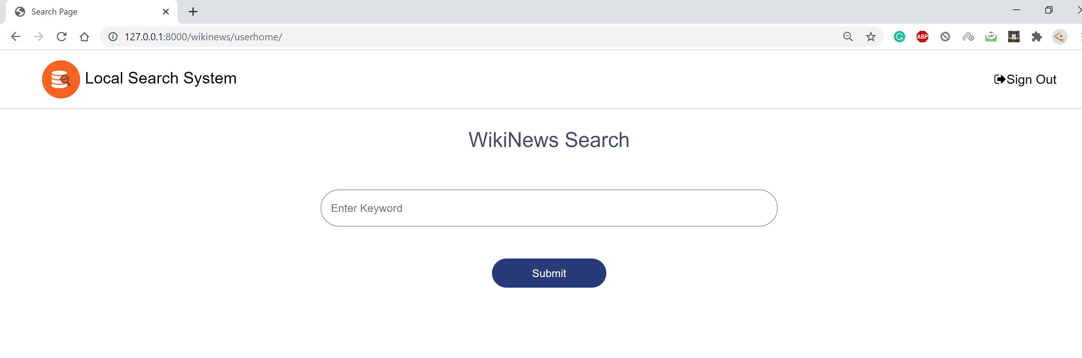
Search page:

Slide 23
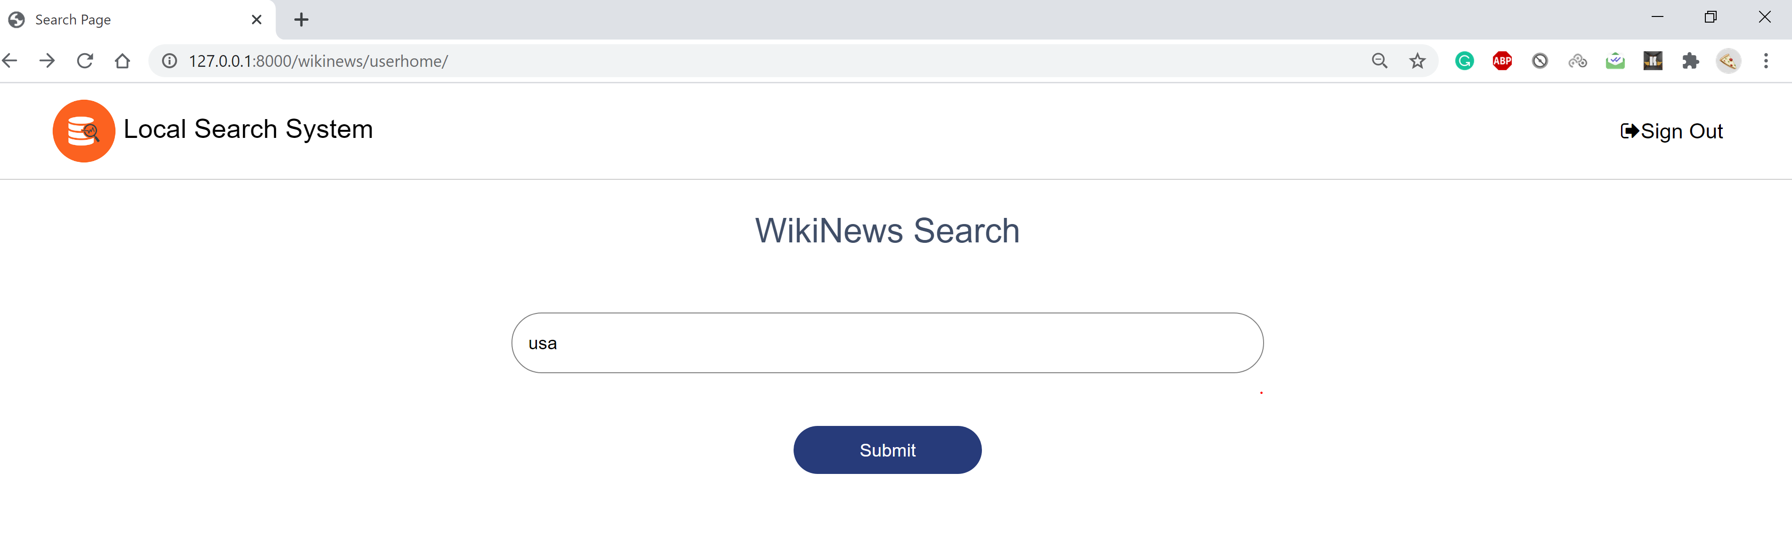
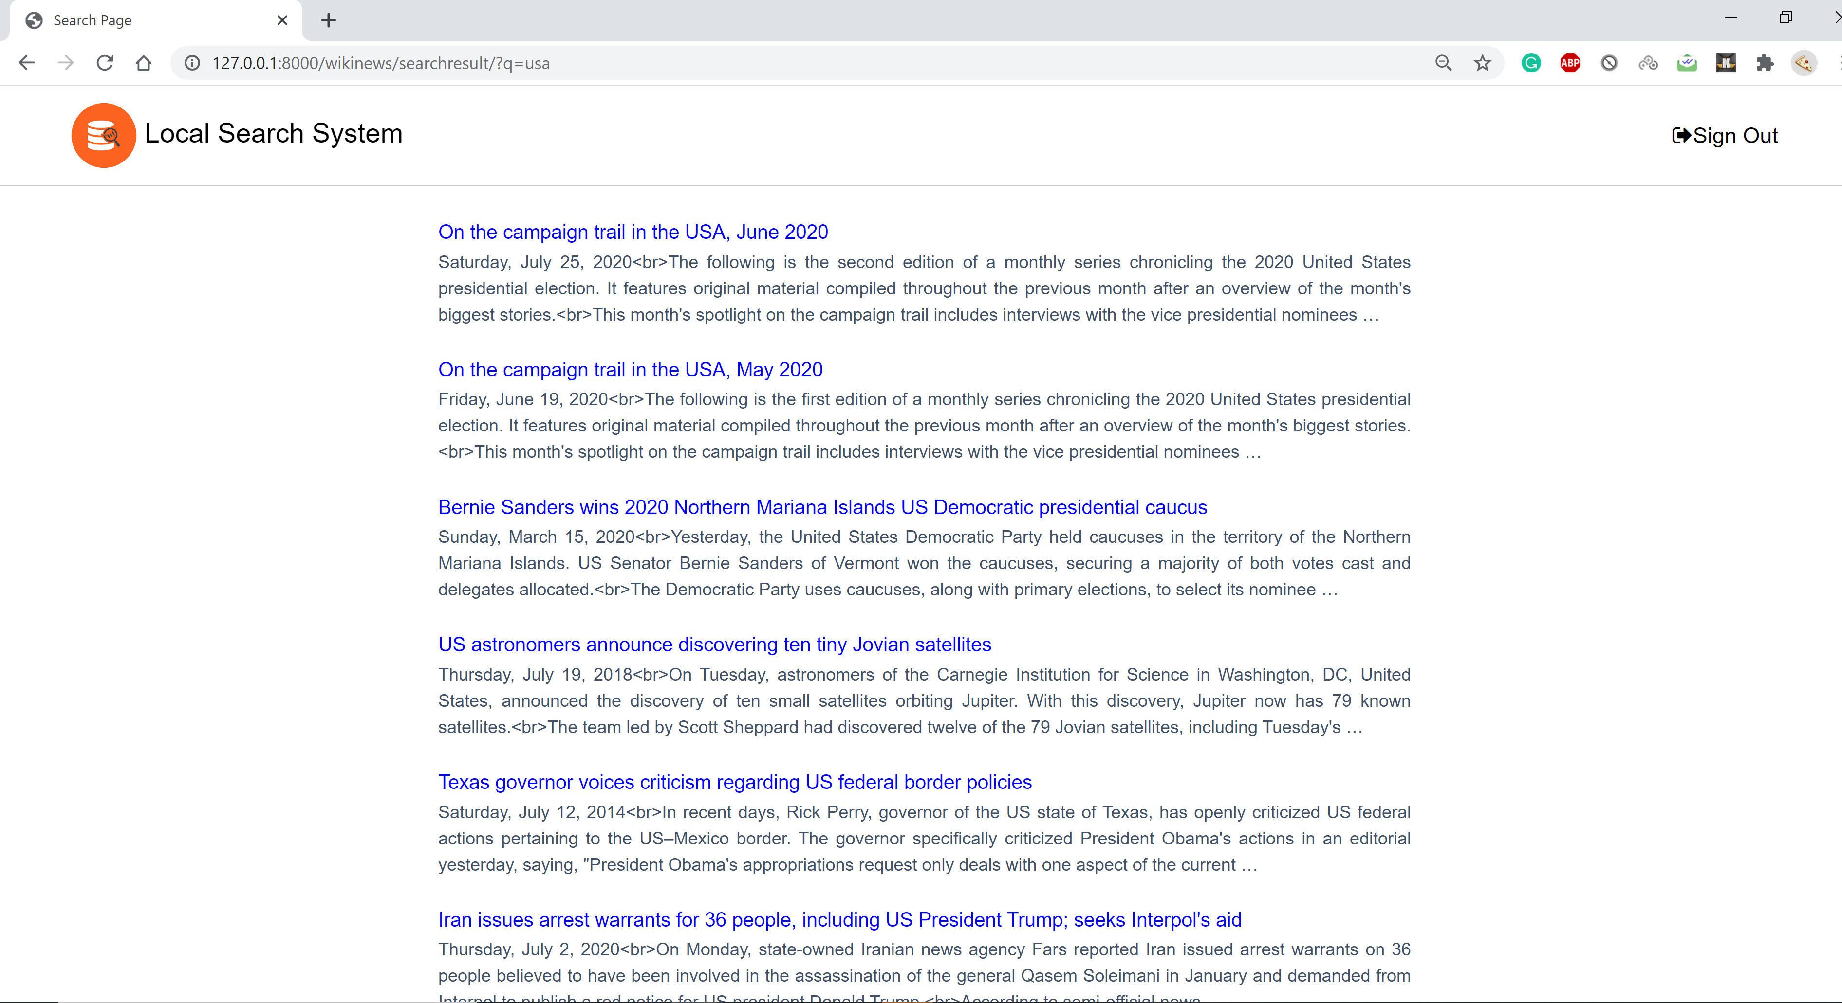
Search page and its results for keyword “usa” from local database

Slide 24
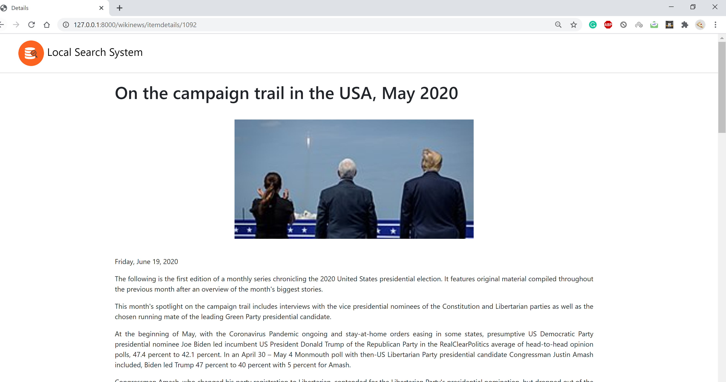
Detail page of each search result

Slide 25
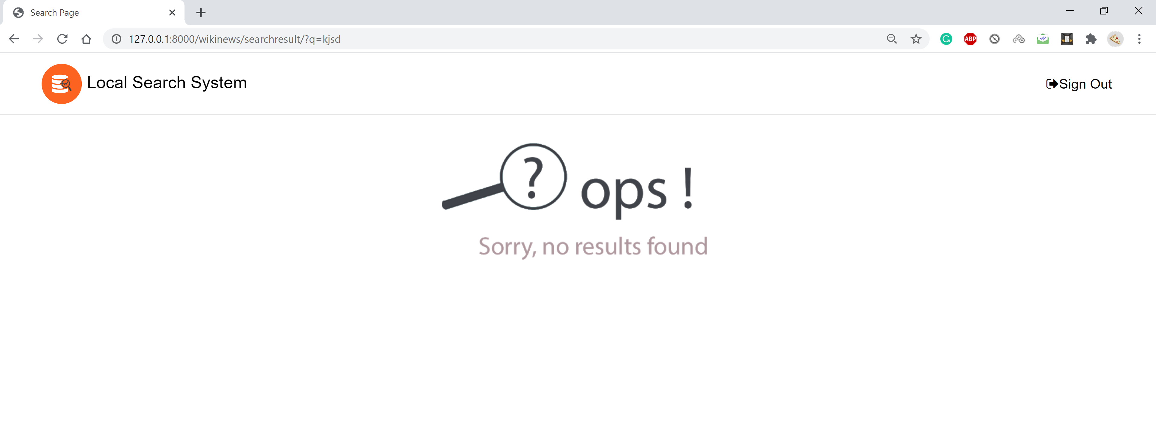
No search results found

Slide 26
Validations

Slide 27
Django form class is used for validations.
Different forms classes are developed for different pages like UserLoginForm and NewUserForm.
Handle the required field validations.
Handle the database model validations through forms.

Slide 28
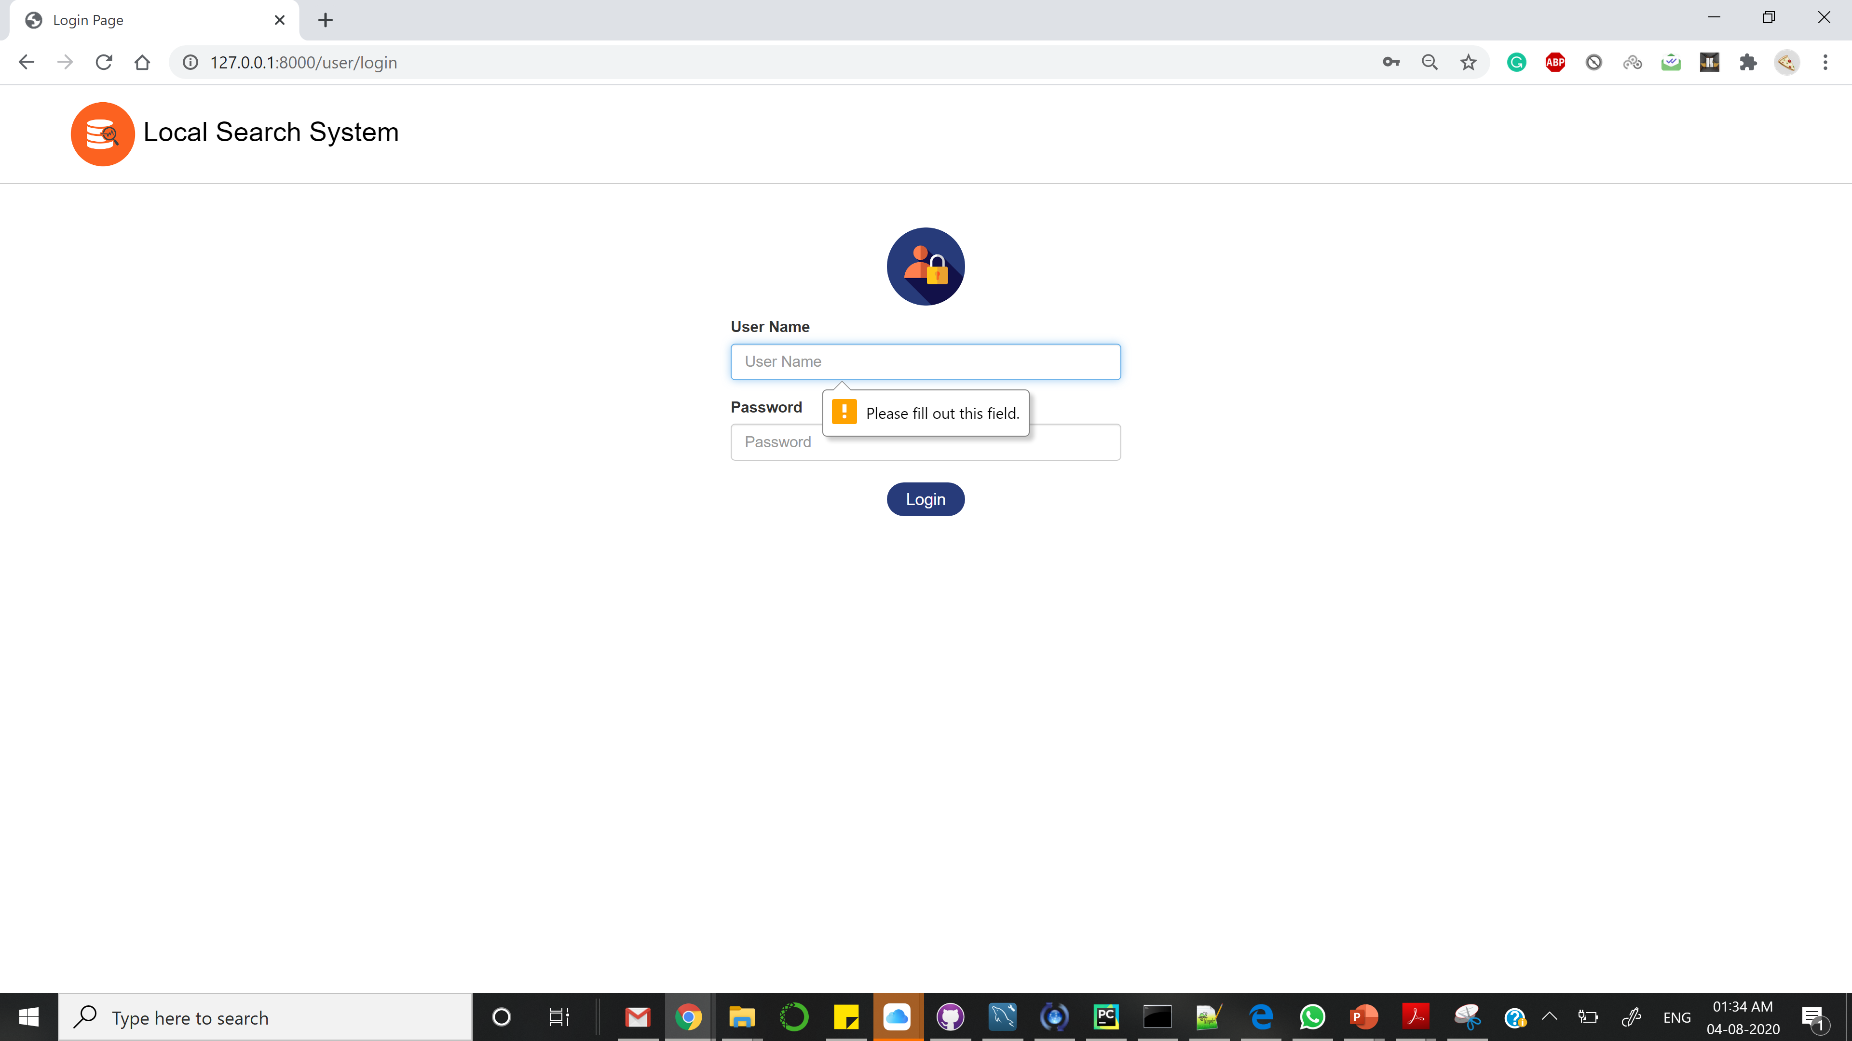
Required field validation

Slide 29
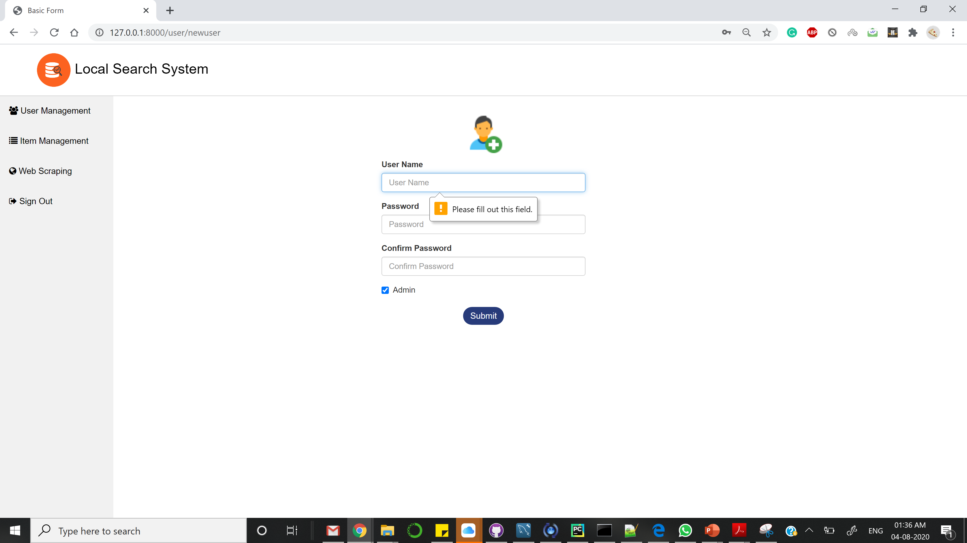
Required field validation

Slide 30
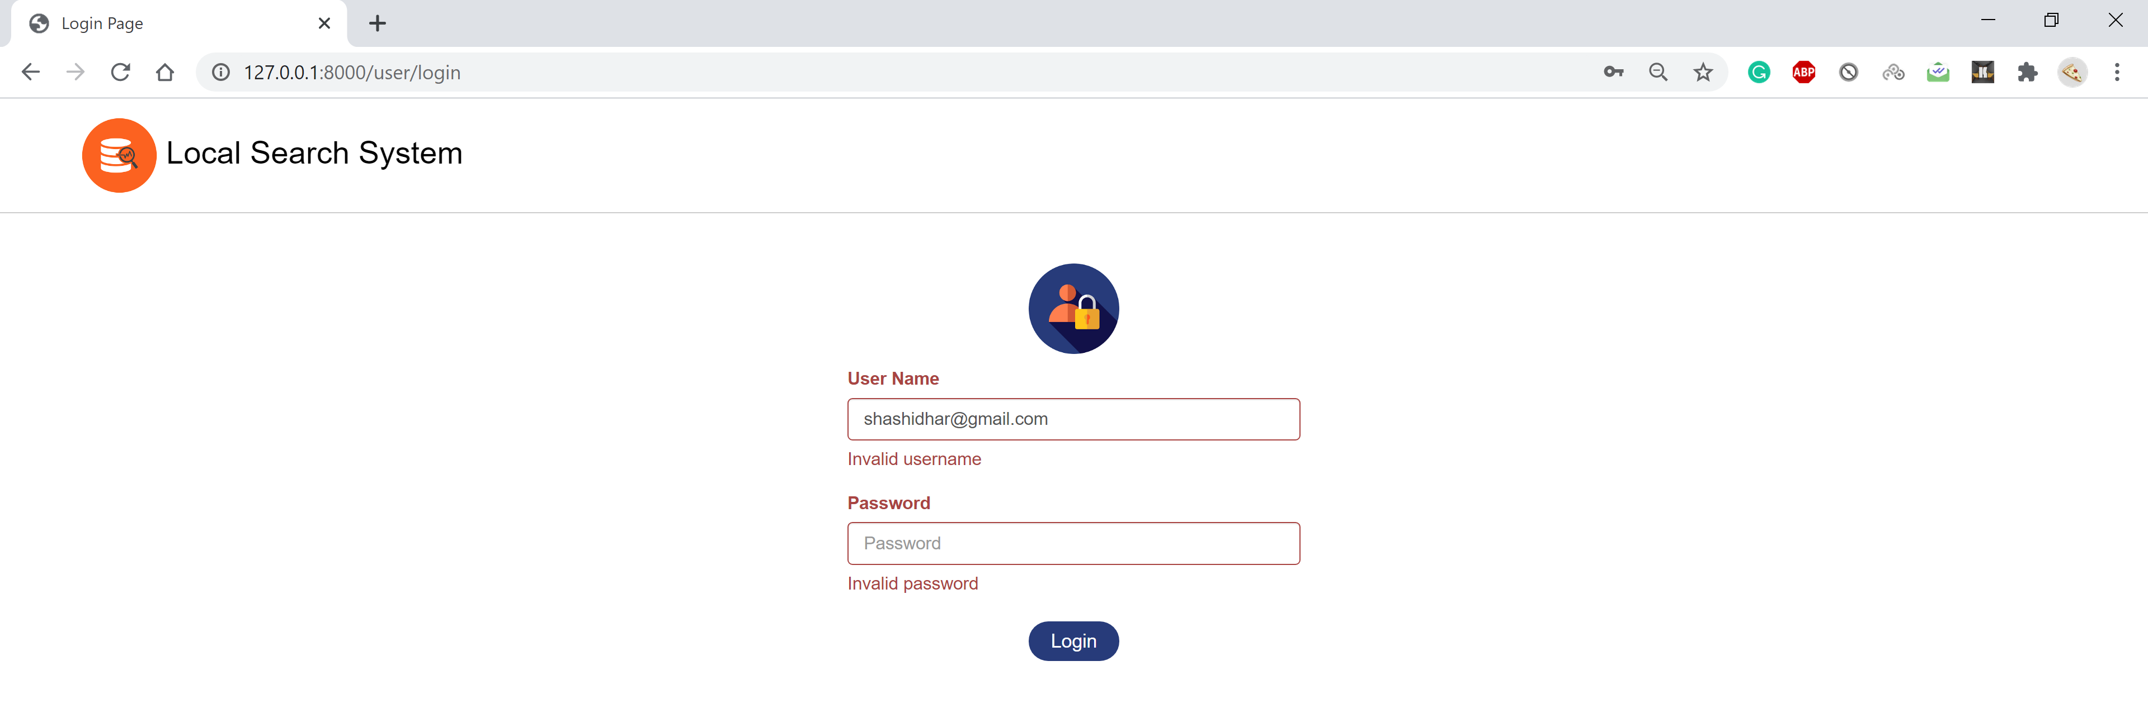
Login page validation

Slide 31
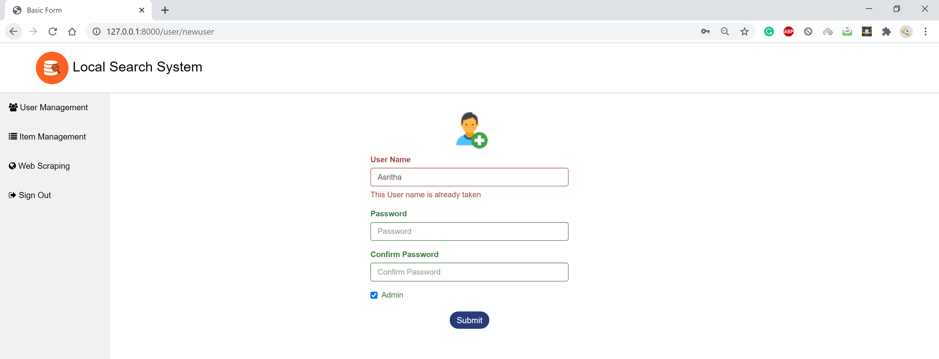
New user page validation

Slide 32
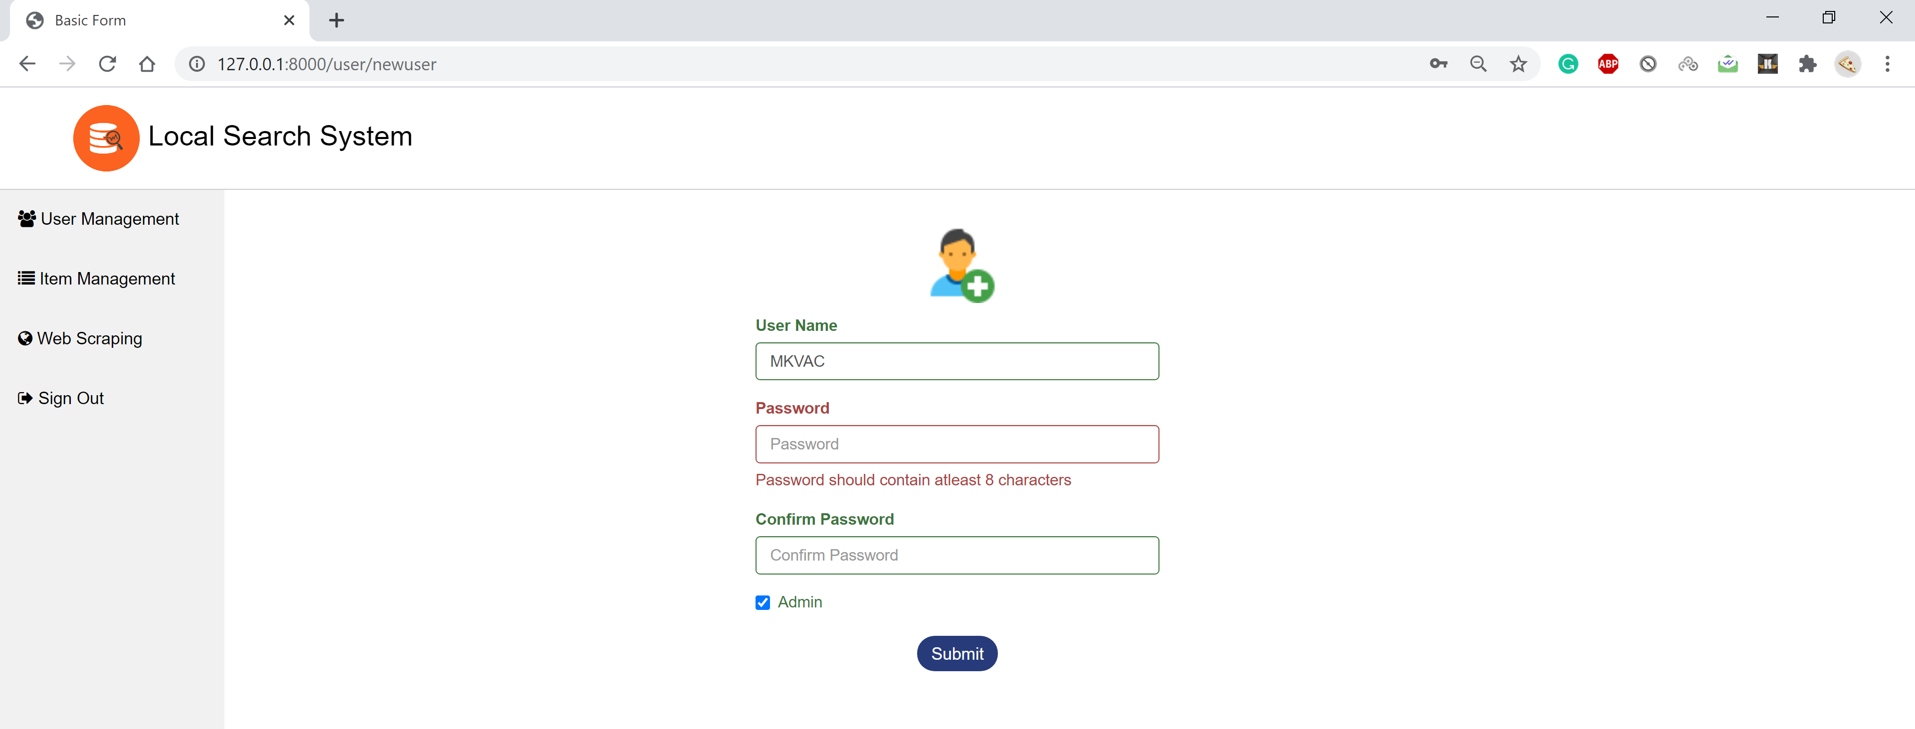
New User page validation

Slide 33
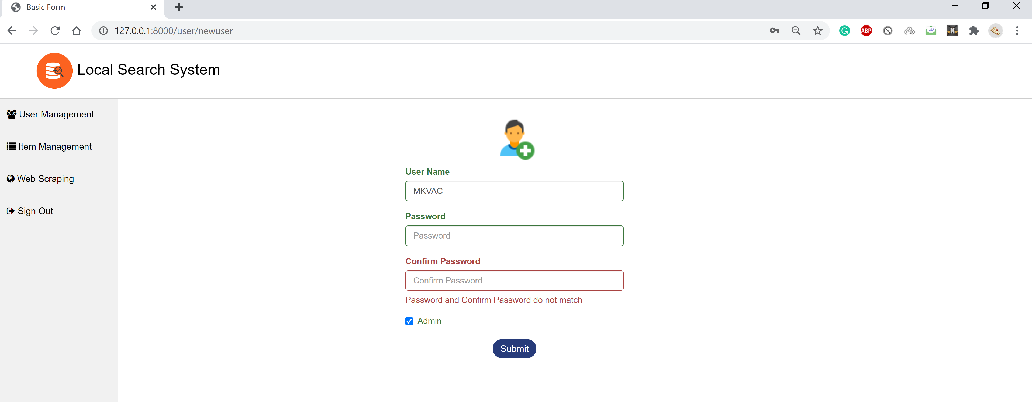
New User page validation

Slide 34
Thank You

